Slide 1
Arlington Career Center - Community Questions
Question:
How many students are driving to the Career Center?
Response:
An estimate of the amount of students driving to the Career Center can be determined by multiplying the number of driving-age students with the percentage that drive (i.e., driving mode split). Based on the latest APS surveys, the percentage of driving age students at the Career Center that drive to school is 16%. APS has set a target goal of reducing this percentage to 12% in the future. Using this information, the existing number of students driving to the Career Center is between around 69 students, while the number of students expected to drive to the campus in the future, assuming a maximum site capacity, is between 64 and 83 students (depending on if the mode split target is met).
Condition | Estimated Number of Students (of driving age) | Driving Mode Split | Driving Mode Split (Based on TDM) | Students Driving to the Campus
 |  | Base TDM (2016 APS GO!) | Enhanced TDM (Mode Split Targets) | Existing mode splits | Mode Split Targets
Existing | 430* | 16% | --- | 69 | ---
Proposed Site Max | 523** | 16% | 12% | 84 | 63
*Based on September 2021 APS Monthly enrollment (11th and 12th grade students)
** Based on anticipated program enrollment in the Ed Specs

Slide 2
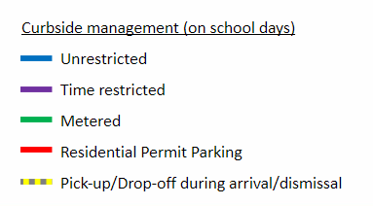
Arlington Career Center - Community Questions
Question:
How much unrestricted parking around the site is there? Does or will this include metered parking? Where are the 80 street parking spaces referenced in the presentation?
Response:
Directly adjacent to the Career Center, there are a total of 177 parking spaces: 84 unrestricted, 30 time-restricted, 35 metered, and 13 residential permit parking spaces. There are 15 additional spaces with restrictions during arrival/dismissal.
13
10
9
7
12
3
3
4
3
6
1
19
16
7
4
3
5
7
11
20
14

Slide 3

Arlington Career Center - Community Questions
Question:
How much unrestricted parking around the site is there? Does or will this include metered parking? Where are the 80 street parking spaces referenced in the presentation?
Response (Continued):
After the completion of the Complete Streets project on S Walter Reed, the number of spaces will increase to approximately 191 total, with 178 non-permit spaces and 13 residential permit parking are expected. The County can change the management of the non-permit spaces may change in the future.
13
10
3
7
12
3
7
3
1
6
17
16
7
4
3
11
7
12
22
14

Slide 4
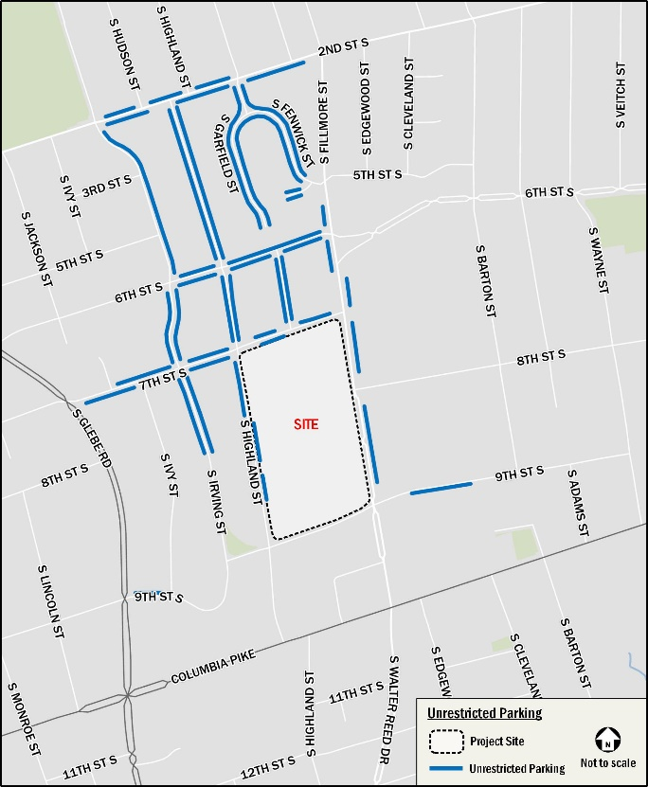
Arlington Career Center - Community Questions
Question:
Will On-Street parking be available for students driving from their home schools?
Response:
Within a short walk of the site, there are approximately 512 unrestricted spaces. Based on data collected on November 18, 2021, the peak on-street occupancy of the unrestricted spaces in the neighborhood was 221 vehicles out of 512 available spaces (with 291 spaces still available). As shown below, >50 percent of the spaces are unoccupied during the school day.

