Slide 1
APS Strategic Plan Steering Committee
November 16, 2017

Slide 2
Agenda
Welcome and Introductions
Mission and Vision
Hopes and Aspirations
Dream: What’s Possible
Closing

Slide 3
Working Agreements
Assume positive intentions
Allow everyone’s voice to be heard
Focus on the work
Promote a sense of inquiry
Pay attention to self and others
Collaboration will formulate the milestones for creating the strategic plan
Consensus will be the goal
Acceptable rather than the perfect
Best intentions rather than winning a point
School Board makes the final decision

Slide 4
Housekeeping
Notes
Notes Checkers
Questions from Prior Meeting
Accessibility
Community Outreach
Civic Associations
School Ambassadors
Out of School Time Council, Sat. Nov. 4

Slide 5
Outcomes
By the end of our process, participants will:
Use our current data to provide clarity and focus for APS
Define the ideal state of the district
Develop a wide-range of goals, strategies, and objectives to reach the ideal state
Going from What If… to Results

Slide 6
Design Thinking
DESIGN |  |  | CONSTRUCT
Understand: Ends in INSIGHT | Create: Ends in IDEAS |  | Deliver: Ends in REALITY
Define | Ideate | Scale | Adopt | Implement
What is our current state? What is happening locally? At the State? Nationally? | How do we reach our vision? Key ideas? | What is most important in reaching our vision? |  | What action steps will be taken to implement the strategies? What are the results?
Mission Vision Core Values | Goals Strategies Objectives | Goals Strategies Objectives | Strategic Plan | Action Steps Results

Slide 7
Mission, Vision, and Core Values
Hopes and Aspirations
(November 16)
Current State
(November 27)
Mission, Vision, & Core Values
(December 5)

Slide 8
Mission and Vision

Slide 9
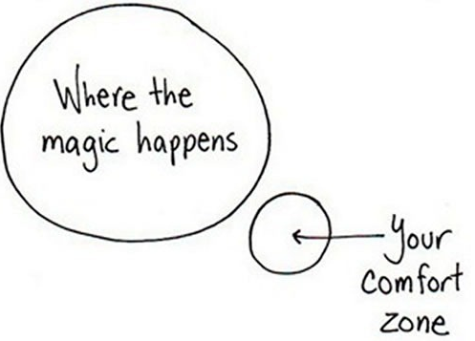
Hopes and Aspirations

Slide 10
Mission
Why do we exist? What defines our purpose?
Notes:
Chart paper

Slide 11
Mission
In your group, review the Hopes and Aspirations responses.
Use the information from the responses to answer:
Why do we exist? What defines our purpose?
Limit each individual idea to one sentence or phrase.
Notes:
Chart paper

Slide 12
Mission: Gallery Walk
Notes:
Chart paper

Slide 13
Dream: What’s Possible

Slide 14
Vision
What do we aspire to achieve in the future?
Notes:
Chart paper

Slide 15
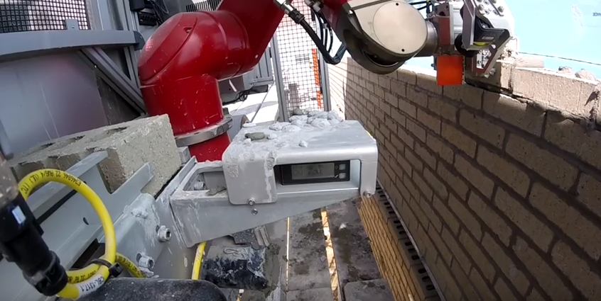
The Future of Schools and Jobs

Slide 16
DREAM

Slide 17
Competencies and Attributes
In your group, review the assigned resources.
Jot down the phrases or sentences that stand out to you.
After your group is finished, share what you wrote and why.
Then…
Circle those words in the phrases and sentences that are most impactful.
List any competencies or attributes from your assigned resource that you believe APS students would need.

Slide 18
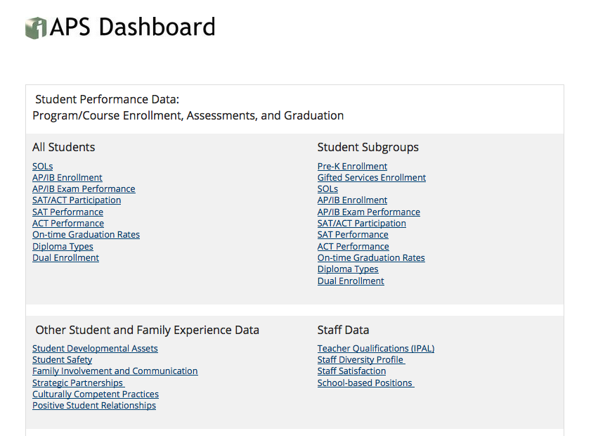
Follow-Up: Data Dashboard

Slide 19
Follow-Up: Assigned Readings
Read:
Whole Child Framework
Master Planning Committee Report
Community Facility Study and 2015 Report
2017 Baldrige Self Assessment
Arlington’s 2017 Youth Risk Behavior Survey
Review and be familiar with:
Advisory Committee on Instruction’s Annual Reports
Program Evaluations

Slide 20
Public Comment

Slide 21
Closing

