Slide 1
APS Strategic Plan Steering Committee
November 27, 2017
Notes:
Promises/commitments

Slide 2
Agenda
Welcome: Competencies and Attributes
Current State:
Hanover Report (vision)
Core Values
Public Comment
Closing

Slide 3
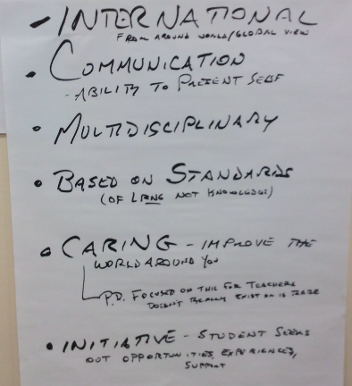
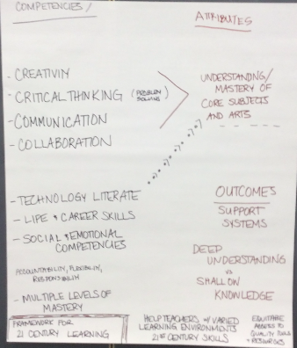
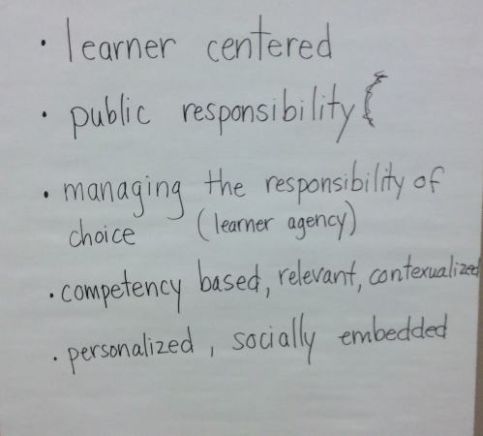
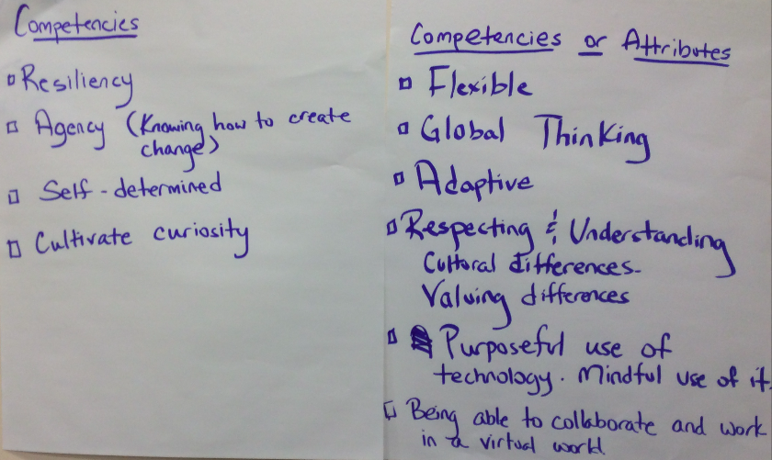
Welcome: Competencies and Attributes

Slide 4
Working Agreements
Assume positive intentions
Allow everyone’s voice to be heard
Focus on the work
Promote a sense of inquiry
Pay attention to self and others
Formulate the milestones for creating the strategic plan through collaboration
Create a goal of consensus
Acceptable rather than the perfect
Best intentions rather than winning a point
Keep in mind, the School Board makes the final decision

Slide 5
Housekeeping
Notes
Questions from Prior Meeting
Previous two APS strategic plans
3-5 year action plan (developed 2016-17)
Community outreach timeline and plan

Slide 6
Outcomes
By the end of our process, participants will:
Use our current data to provide clarity and focus for APS
Define the ideal state of the district
Develop a wide-range of goals, strategies, and objectives to reach the ideal state
Going from What If… to Results

Slide 7
Design Thinking
DESIGN |  |  | CONSTRUCT
Understand: Ends in INSIGHT | Create: Ends in IDEAS |  | Deliver: Ends in REALITY
Define | Ideate | Scale | Adopt | Implement
What is our current state? What is happening locally? At the State? Nationally? | How do we reach our vision? Key ideas? | What is most important in reaching our vision? |  | What action steps will be taken to implement the strategies? What are the results?
Mission Vision Core Values | Goals Strategies Objectives | Goals Strategies Objectives | Strategic Plan | Action Steps Results

Slide 8
Mission, Vision, and Core Values
Hopes and Aspirations: Mission and Vision
(November 16)
Vision and Core Values
(November 27)
Mission, Vision, & Core Values
(December 5)

Slide 9
Vision

Slide 10
External Scan
Key Considerations | Opportunities | Threats
Those items that you feel are most important | External factors that are likely to have a positive effect on achieving or exceeding our goals | External factors and conditions that are likely to have a negative effect on achieving our goals

Slide 11
External Scan + Future of Education = Vision

Slide 12
Vision
What do we aspire to achieve in the future?
Notes:
Chart paper

Slide 13
Core Values

Slide 14
Core Values: What We Stand For
Silent Appointment Dyad
Each person will have three minutes to share their five to six values and beliefs that are most important
After sharing, circle those five that remain most important

Slide 15
Core Values
Each student is entitled to an excellent education that meets his or her individual needs.
Dynamic and supportive partnerships among students, parents, educators, and the community are critical to meet student needs and provide enriching experiences.
Effective educators are essential to student success.
Families play a fundamental role in their children’s education.
High expectations inspire high performance.
Everyone thrives in a vibrant, healthy, safe, enriching, and respectful environment.
Our diversity is a strength that creates resilient, open, and innovative global citizens.

Slide 16
Follow-Up for Next Meeting
Review
Hopes and Aspirations compiled results
Notes from November 16
Notes from November 30
Data Dashboard

Slide 17
Public Comment

Slide 18
Closing

